Slide 1












THE 11TH ANNUAL FORUM
OF THE EU STRATEGY FOR THE DANUBE REGION (EUSDR)
DANUBE STRATEGY FLAGSHIPS
Nicole HAUDER
19-20 OCTOBER 2022

Slide 2

Danube Strategy Flagships
Definition
Projects or processes that contribute to the implementation of the EUSDR, have a clear macro-regional dimension and a multi-level governance approach
To strengthen internal and external communication of the Strategy and the visibility of the topics, initiatives and prospects in the Danube Region
https://danube-region.eu/projects-and-funding/eusdr-strategic-projects/

Slide 3



Danube Strategy Flagships
Scope
STRUCTURE
Project (single or interlinked), Process, Network, Platform…
STATUS
In planning phase, ongoing or completed
FUNDING
use of existing financial sources
Annual List of Danube Strategy Flagships
https://danube-region.eu/projects-and-funding/eusdr-strategic-projects/

Slide 4
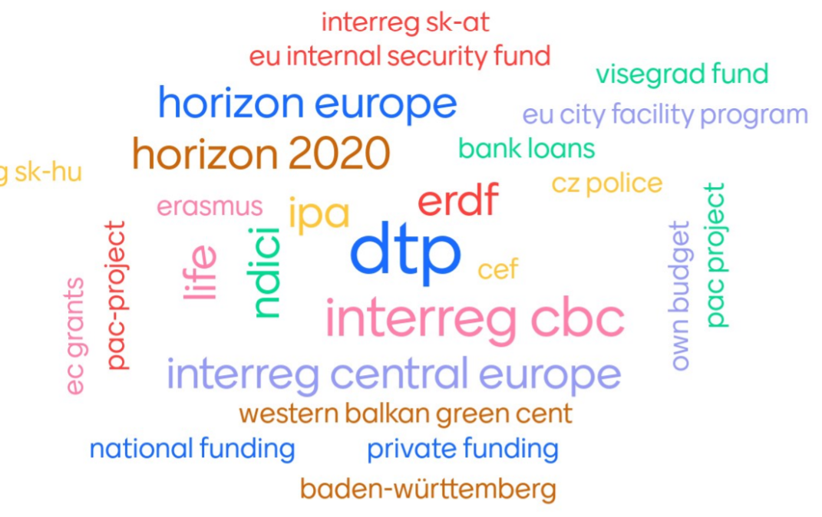
Danube Strategy Flagships
Funding
https://danube-region.eu/projects-and-funding/eusdr-strategic-projects/

Slide 5



Danube Strategy Flagships
Examples
SUSTANCE – Sustainable public transport solutions (PA 1b, PA 10)
Enhancing hydrogen economy in the EUSDR (PA 2)
Flagship process on adaptation to climate change (PA 4, PA 5)
The SUSTANCE project (2023-2025) helps to solve the lack of efficient and sustainable public transport in peripheral and cross-border areas of Central Europe, which have registered an increased mobility at cross-border level in the last decade.
Total Budget: 2.013.259 EUR
Funding Instrument: Interreg Central Europe Programme 2021-2027
→ Further Information
The Flagship will coordinate actions to foster the development of hydrogen economies building on synergies of national actions and favorable conditions of the EUSDR (e.g. potential for green hydrogen production from renewables, tremendous transport facilities such as the Danube or gas infrastructures, etc.).
Potential funding: Horizon Europe, LIFE Clean Energy, Connecting Europe Facility or Interreg Transnational Programmes.
→ Further Information
Within this process PA 4 supports actions in which water availability and water quality are key issues to climate change adaptation. One example of the process developed is the support to international projects (e.g. Deepwater-CE, FramWat, OPTAIN, DanubeFloodplain, DriDanube, IDES, LIFE LOGOS 4 WATERS) which were financed by Interreg Central Europe, Danube Transnational Programme, Horizon 2020 and LIFE.
→ Further Information
https://danube-region.eu/projects-and-funding/eusdr-strategic-projects/

Slide 6


Danube Strategy Flagships
Examples
Western Balkans R&I Information Hub (PA 7, PA 8, PA 10)
ESF Managing Authorities Network in the Danube Region (PA 9, PA 10)
Collaboration for Dismantling Drugs Distribution and Illicit Laboratories (CO3DIL) (PA 11)
The Western Balkans Info Hub is provided by the Horizon Europe project POLICY ANSWERS, which deploys a vast array of tools (high-level meetings, pilot activities, policy recommendations) – to support a better integration of the Western Balkans into the European Research Area.
The project runs from March 2022 until February 2026. Estimated budget for the POLICY ANSWERS project: EUR 4.993.109
→ Further Information
The ESF Network constitutes a platform to facilitate exchange and coordination between the ESF MAs, PAs and the EC as well as further relevant stakeholders. It fosters transnational cooperation within the ESF OPs, connects cooperation and investment, and serves as a knowledge hub for implementation, planning and exchange of experience.
The network is enabled by the PAC projects (DTP) & national funding (MAs).
→ Further Information
The project (2019-2021) focused on international cooperation in the field of detection of illegal laboratories for the production of methamphetamine, including trade in precursors and chemical substances for its production and subsequent distribution networks.
Total budget: EUR 236.195 (90% of the costs were covered by EU Internal Security Fund; 10% by the Police of Czech Republic)
→ Further Information
https://danube-region.eu/projects-and-funding/eusdr-strategic-projects/

Slide 7
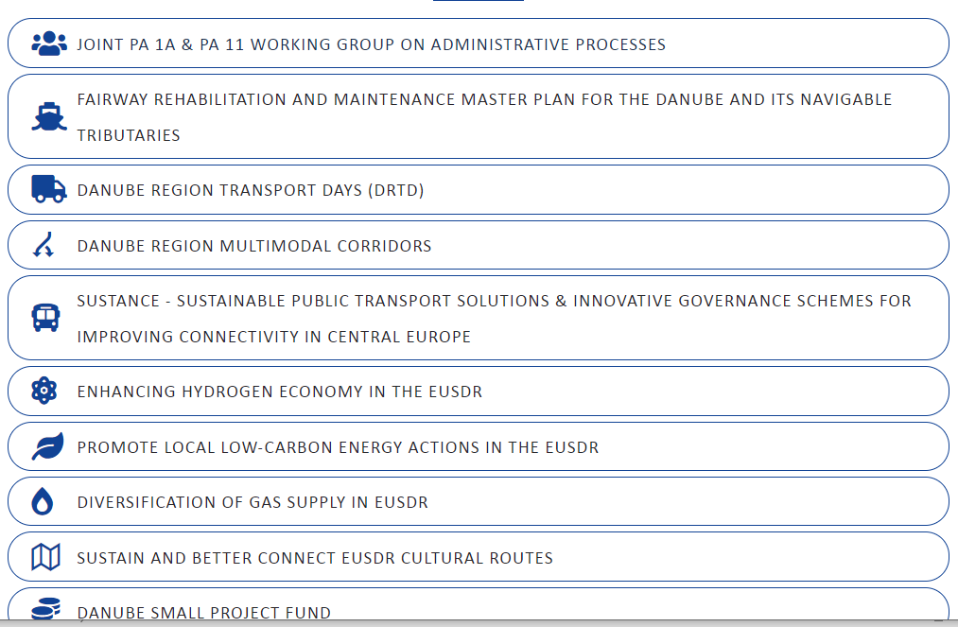
Danube Strategy Flagships
Examples
The List of Danube Strategy Flagships 2022 can be found on the EUSDR Website.
https://danube-region.eu/projects-and-funding/eusdr-strategic-projects/

Slide 8

THANK YOU!
Danube Strategy Point
Nicole HAUDER Evaluation Officer
nicole.hauder@eusdr-dsp.eu

