Slide 1
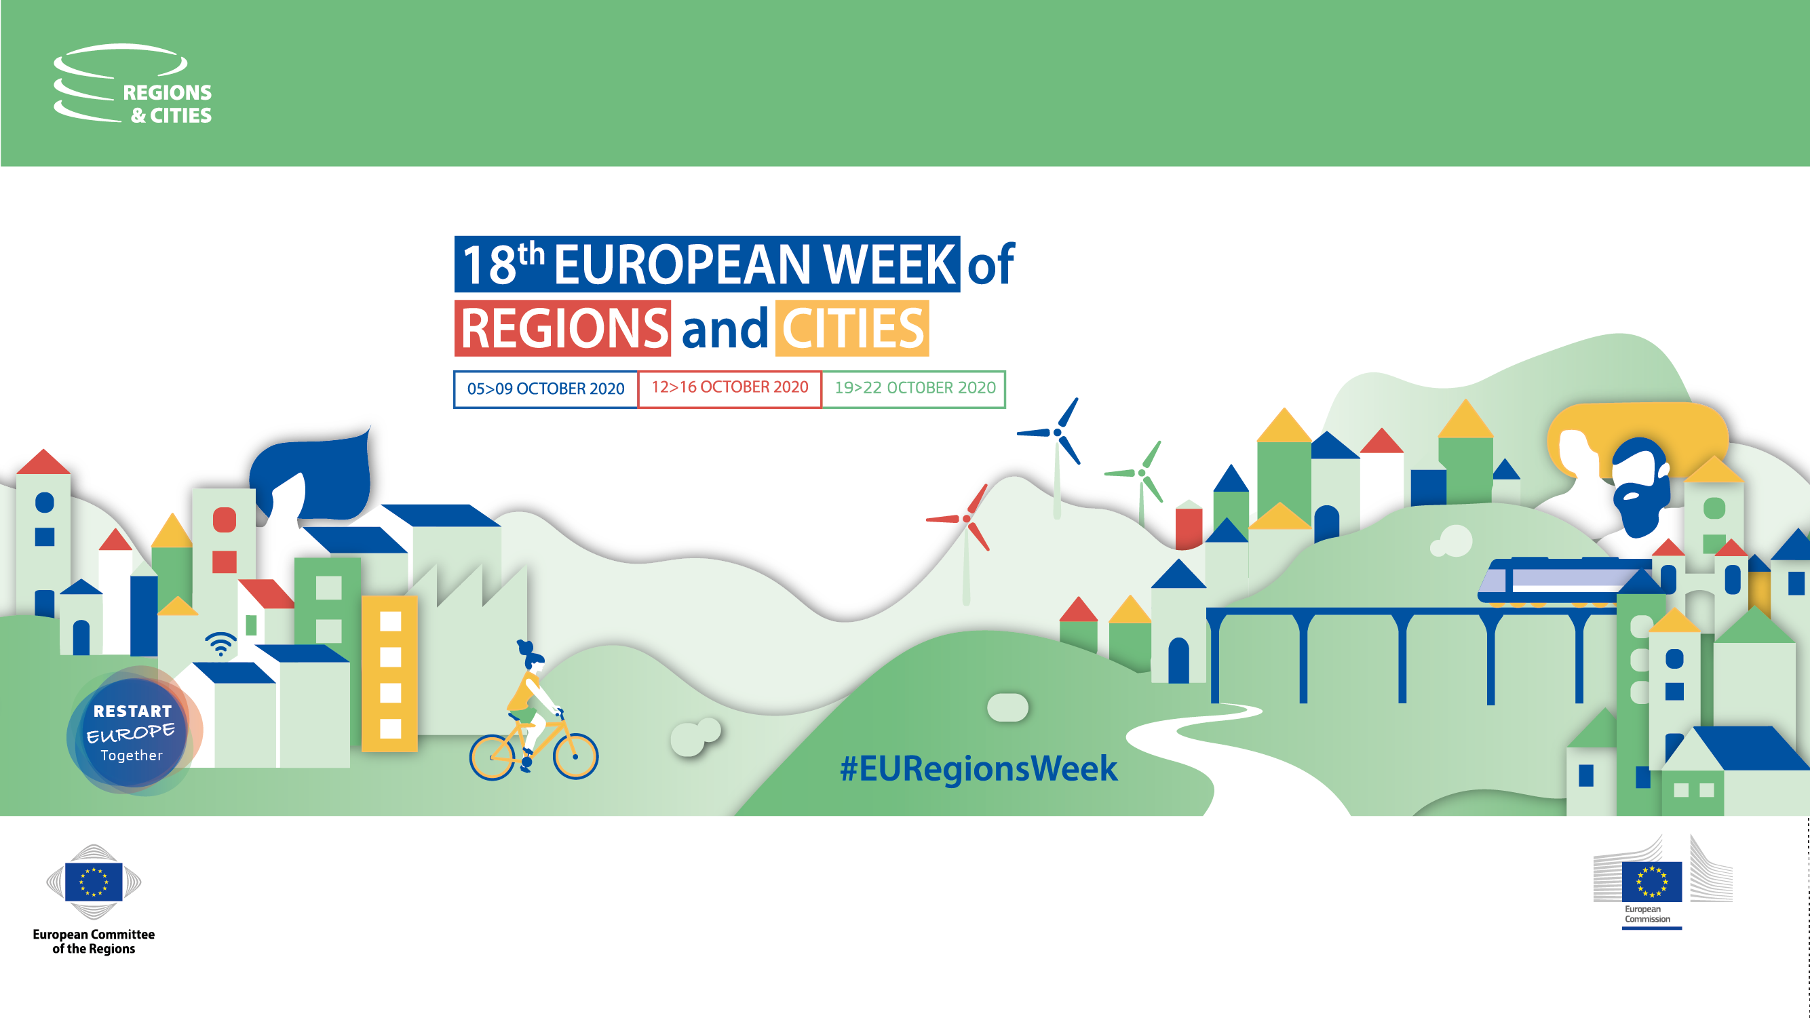





Slide 2


Young Generation
Takes Over the Danube Region
Online event
13.10.2020

Slide 3
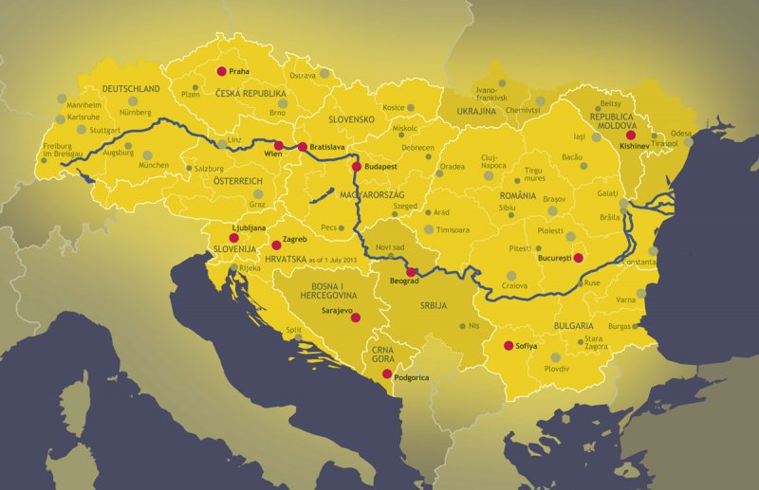


Slide 4
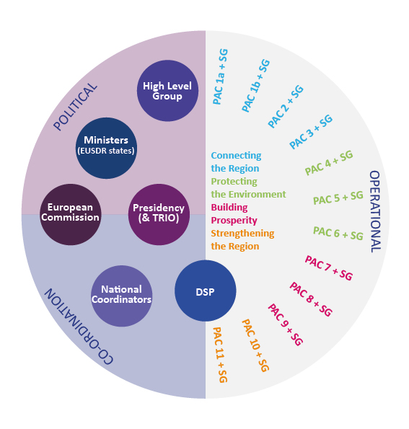
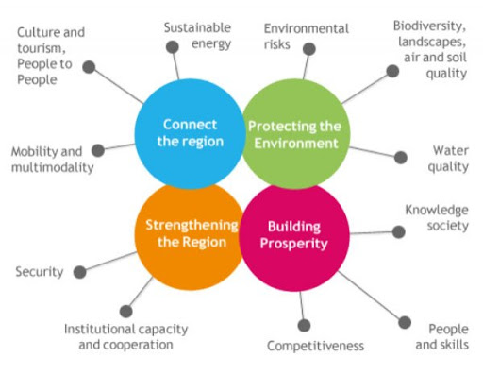
EUSDR– who does what?

Slide 5

EUSDR Revised Action Plan
EUSDR Governance Architecture
Paper
Embedding process
This Photo by Unknown Author is licensed under CC BY-SA

Slide 6


EUSDR Priority Area 7:
Knowledge Society
This Photo by Unknown Author is licensed under CC BY-ND

Slide 7
improving the framework conditions for building a knowledge society
fostering cooperation in the Danube Region
strengthening the achievement of the European Research Area
fostering brain circulation
further implementing Smart Specialization Strategies

Slide 8
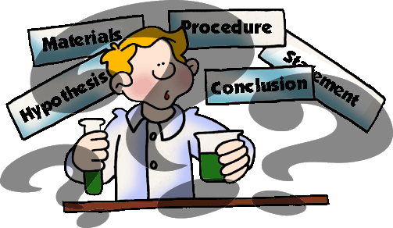
This Photo by Unknown Author is licensed under CC BY-NC-ND

Slide 9


EUSDR Priority Area 8:
Competitiveness
of Enterprises

Slide 10
improving digital skills of the entrepreneurs
overcoming the current gap between regional strategies and cluster strategies
supporting the development of innovative and digital capacities of female-led start-ups
enhance the application of Artificial Intelligence technologies

Slide 11


Slide 12


EUSDR Priority Area 9:
People & Skills
This Photo by Unknown Author is licensed under CC BY-SA

Slide 13
finding innovative solutions for tackling youth unemployment
improving educational outcomes, skills and competences
increasing the quality and efficiency of education, training and labour market systems
ensuring inclusive education
ensuring lifelong learning opportunities for all

Slide 14
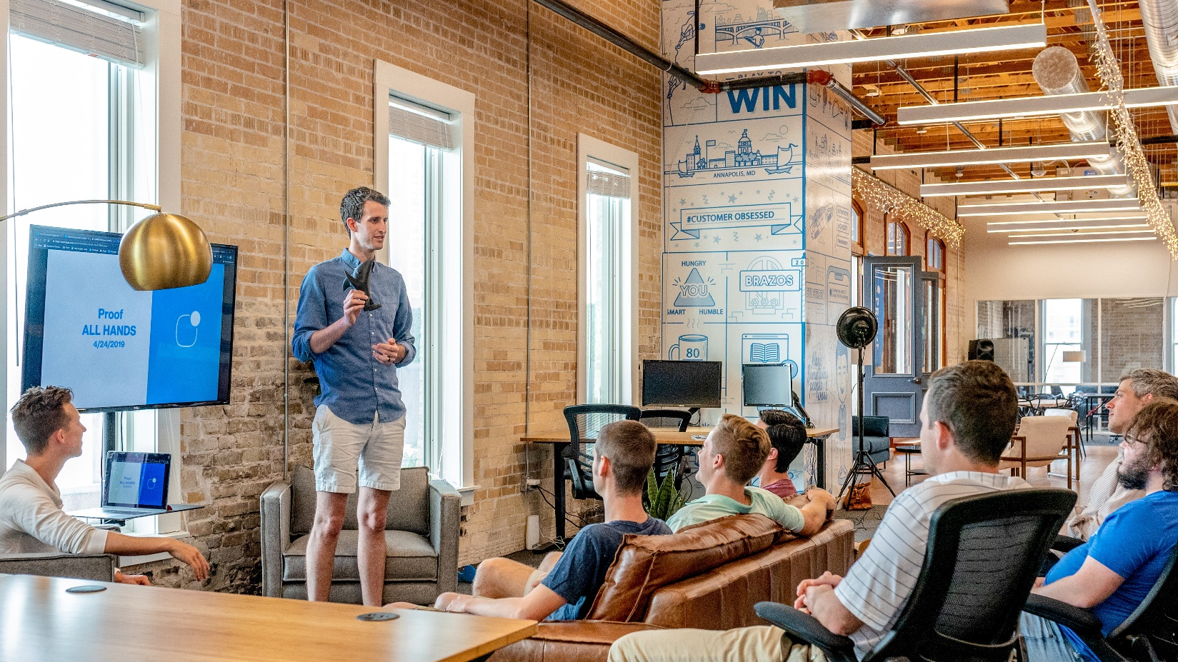

Slide 15


EUSDR Priority Area 10:
Institutional Capacity & Cooperation

Slide 16

increasing involvement of civil society and local actors for effective policy-making and implementation
better use of funding and needs-based funding instruments

Slide 17

This Photo by Unknown Author is licensed under CC BY-SA-NC

Slide 18

Cooperation is the key.
Everybody is invited to join.
This Photo by Unknown Author is licensed under CC BY-NC-ND

Slide 19
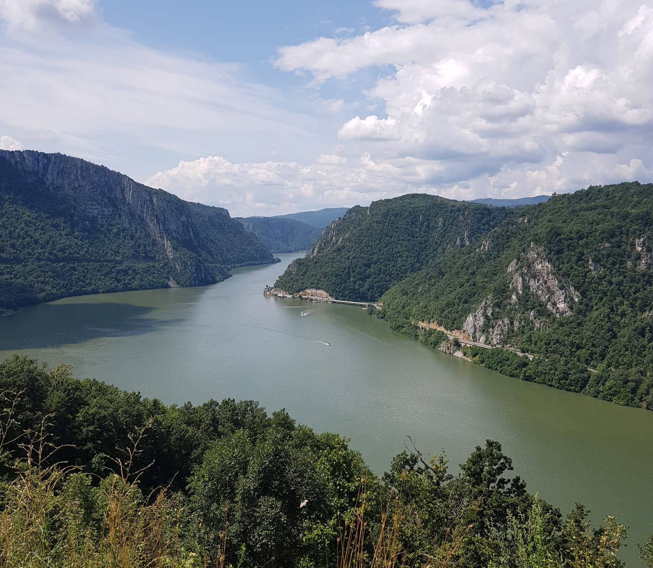
Thank you for your attention!
www.danube-region.eu
office@eusdr-dsp.eu

